Slide 1
交换机

Slide 2
Switch
link-layer device: smarter than hubs, take active role
store, forward Ethernet frames
examine incoming frame’s MAC address, selectively forward frame to one-or-more outgoing links when frame is to be forwarded on segment, uses CSMA/CD to access segment
transparent
hosts are unaware of presence of switches
plug-and-play, self-learning
switches do not need to be configured

Slide 3
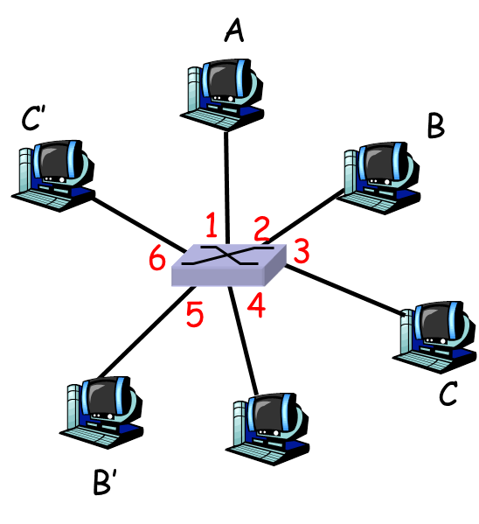
Switch: allows multiple simultaneous transmissions
hosts have dedicated, direct connection to switch
switches buffer packets
Ethernet protocol used on each incoming link, but no collisions; full duplex
each link is its own collision domain
switching: A-to-A’ and B-to-B’ simultaneously, without collisions
not possible with dumb hub
switch with six interfaces
(1,2,3,4,5,6)

Slide 4
Switch Table
Q: how does switch know that A’ reachable via interface 4, B’ reachable via interface 5?
A: each switch has a switch table, each entry:
(MAC address of host, interface to reach host, time stamp)
looks like a routing table!
Q: how are entries created, maintained in switch table?
something like a routing protocol?
switch with six interfaces
(1,2,3,4,5,6)

Slide 5
Switch: self-learning
switch learns which hosts can be reached through which interfaces
when frame received, switch “learns” location of sender: incoming LAN segment
records sender/location pair in switch table
Source: A
Dest: A’
A
A A’
C’
B
1
2
6
3
5
4
Switch table
(initially empty)
MAC addr interface TTL
C
A
1
60

Slide 6
Switch: frame filtering/forwarding
When frame received:
1. record link associated with sending host
2. index switch table using MAC dest address
3. if entry found for destination then {
if dest on segment from which frame arrived then drop the frame
else forward the frame on interface indicated
}
else flood
forward on all but the interface
on which the frame arrived

Slide 7
Self-learning, forwarding: example
Source: A
frame destination unknown:
Dest: A’
flood
A
A A’
destination A location known:
C’
B
selective send
Switch table
(initially empty)
1
2
6
3
A A’
A A’
A A’
A A’
A A’
MAC addr interface TTL
5
4
A
1
60
A’
4
60
C
A’ A
B’
A’

Slide 8
Interconnecting switches
switches can be connected together
Q: sending from A to G - how does S₁ know to forward frame destined to F via S₄ and S₃?
A: self learning! (works exactly the same as in single-switch case!)
S₄
S₁
S₃
A
S₂
F
D
I
B
C
G
H
E

Slide 9
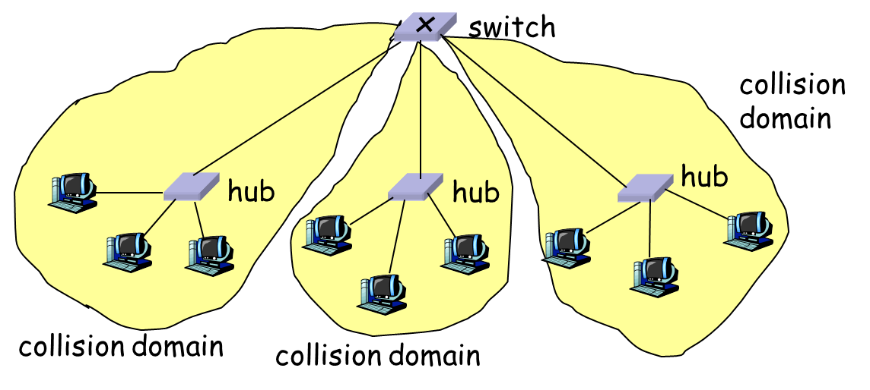
Switch: traffic isolation
switch installation breaks subnet into LAN segments
switch filters packets:
same-LAN-segment frames not usually forwarded onto other LAN segments
segments become separate collision domains

Slide 10
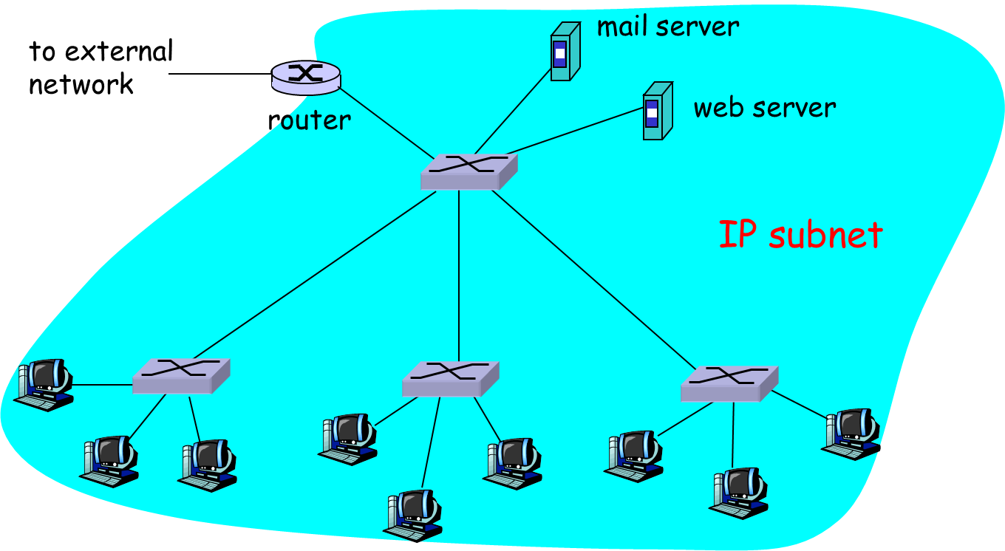
Institutional network

Slide 11
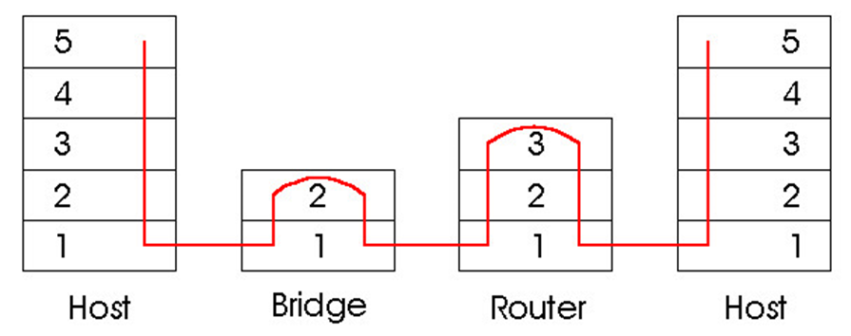
Switches vs. Routers
both store-and-forward devices
routers: network layer devices (examine network layer headers)
switches are link layer devices
routers maintain routing tables, implement routing algorithms
switches maintain switch tables, implement filtering, learning algorithms

Slide 12

Summary
Switch

